Slide 1

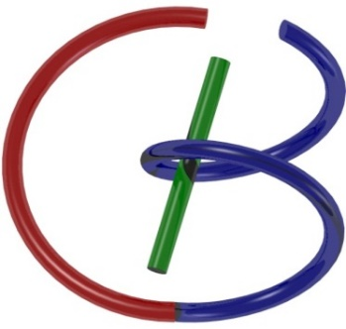
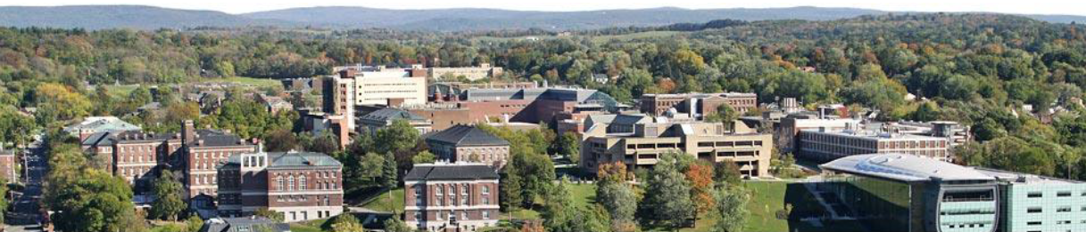
Neuron, Network & Backpropagation
Ge Wang
AI-based X-ray Imaging System (AXIS) Lab
Rensselaer Polytechnic Institute, Troy, New York, USA
September 2, 2021

Slide 2

Your 1 Slide (Key Info, Free Form, with Photo)
Name: ET
RIN: I01234567J
Email: et@rpi.edu
Mobile: 314159265
Department: Future
Interest: Civilization
Courses Learnt: Relativity,
Quantum Mechanics,
GPA: 4.0
Others: Music

Slide 3
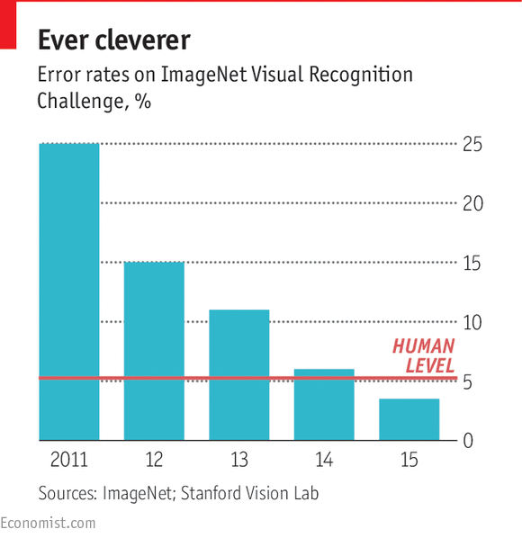
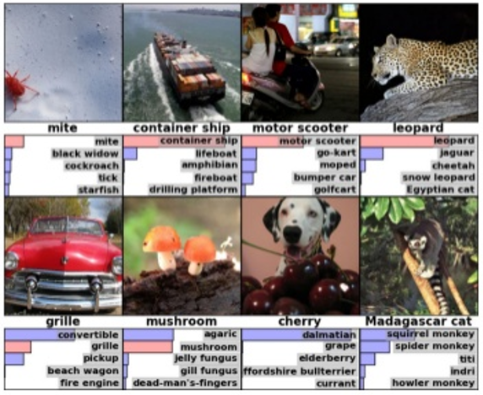
ImageNet Contest
Top-5 error rate is the percentage of test examples for which the correct class was not in the top 5 predicted classes.

Slide 4
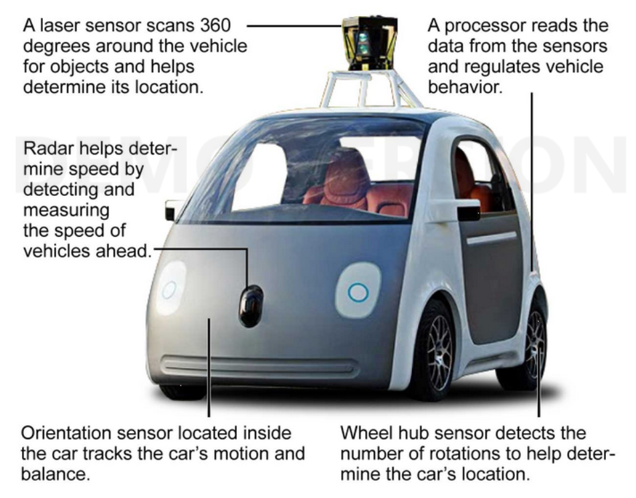
Google’s Self-driving Car

Slide 5
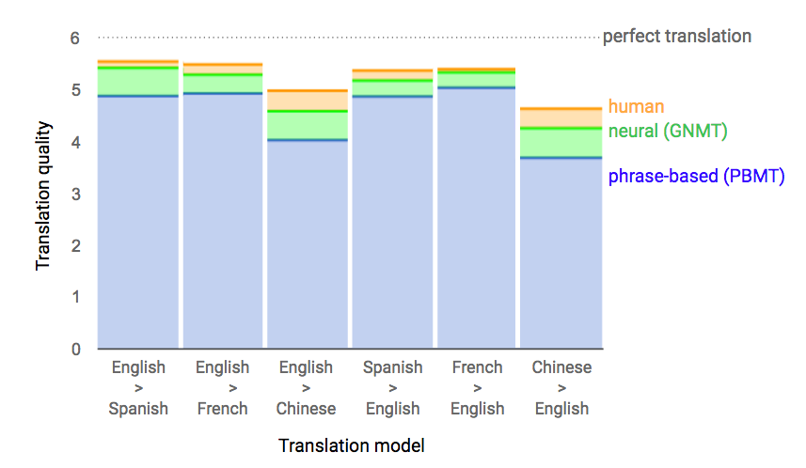
Machine Translation

Slide 6
Outline
Neuron: Biomimicry, Integration, Activation
Network: Connectionism, Feedforward
Backpropagation: Loss, Optimization, Chain Rule

Slide 7
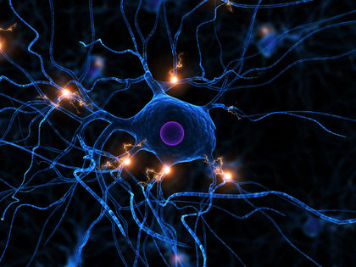
Biological Neuron
http://www.biologyreference.com/Mo-Nu/Neuron.html

Slide 8
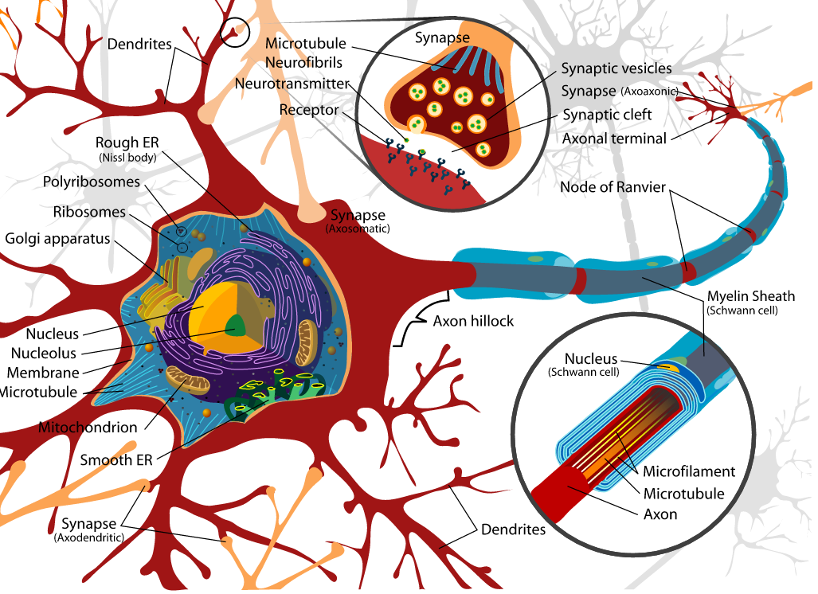
Biological Diagram
Axons carry information from the cell body to the axon terminals
Axon terminals communicate with their target cells at synapses
https://upload.wikimedia.org/wikipedia/commons/a/a9/Complete_neuron_cell_diagram_en.svg

Slide 9
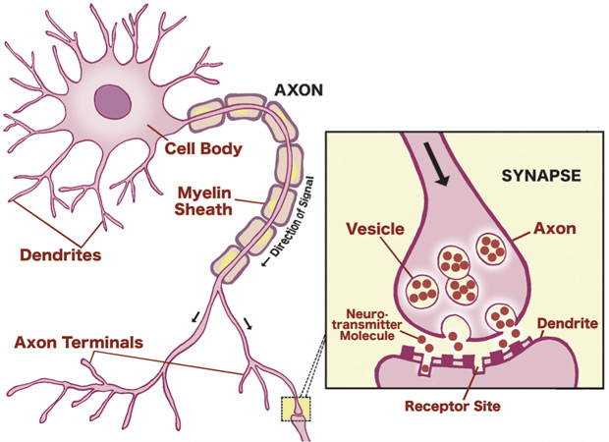
Neuron Cartoon

Slide 10
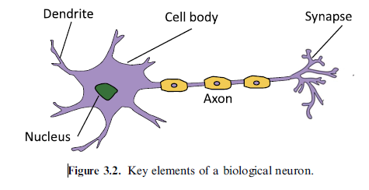
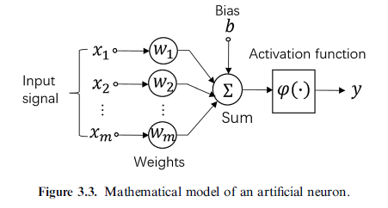
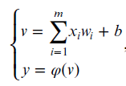
Biological & Artificial Neurons

Slide 11
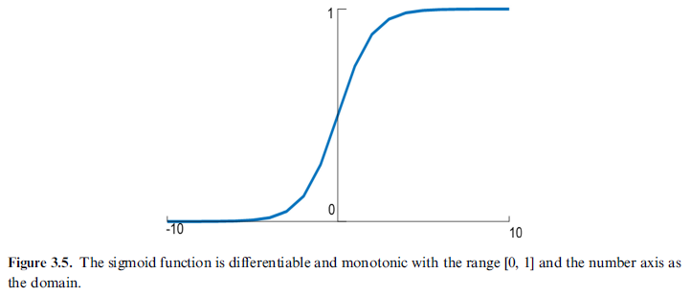
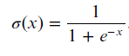
Activation Function: Sigmoid

Slide 12
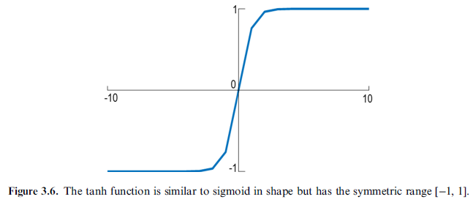
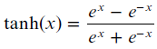
Activation Function: Tanh

Slide 13
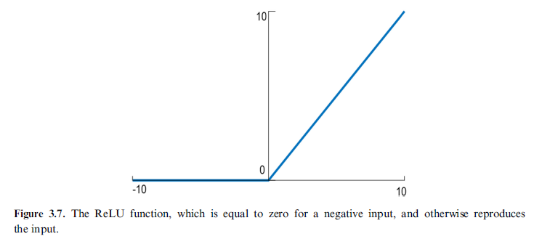
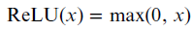
Activation Function: ReLU

Slide 14
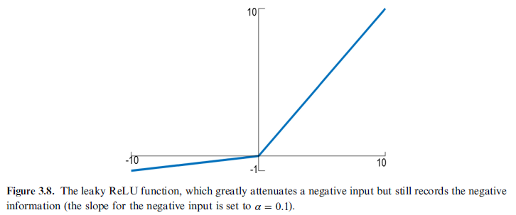
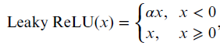
Activation Function: Leaky ReLU

Slide 15
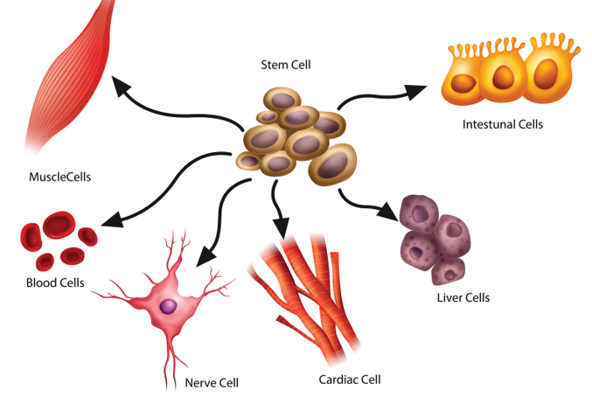
Basic Types of Cells

Slide 16
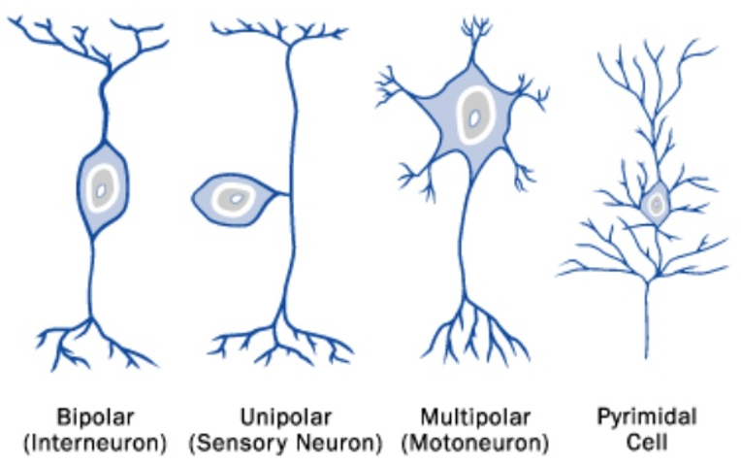
Basic Types of Neurons

Slide 17
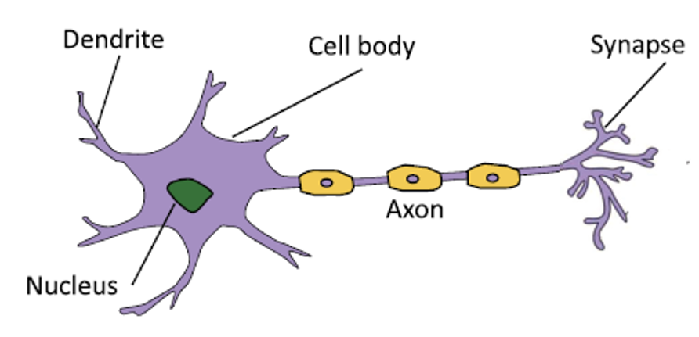
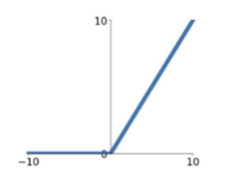
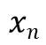
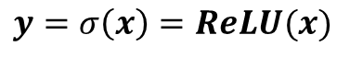
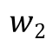
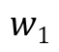
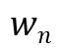
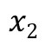
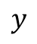
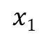
Conventional “Linear” Neuron
Linear
$$x1$$
$$w1$$
Nonlinear
$$w2$$
$$y$$
$$x2$$
…
$$wn$$
Output
$$xn$$
Inner Product
Input
$$y=σ\left(x\right)=ReLU⁡(x)$$

Slide 18
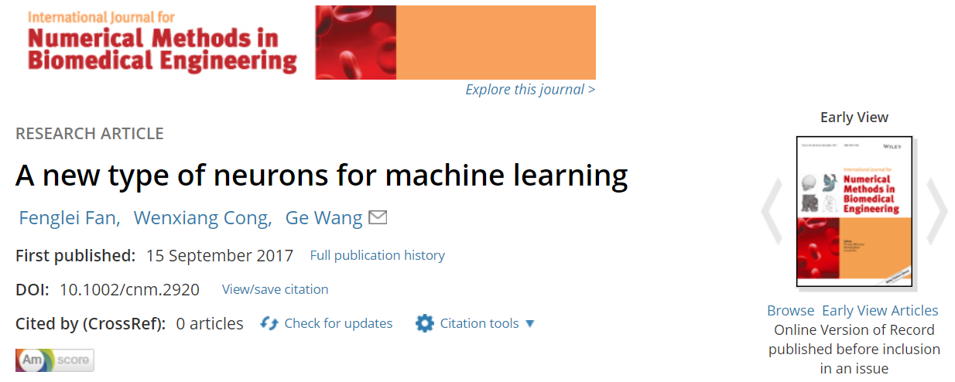
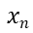
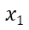
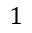
New Type of Neurons
Input
Output
$$1$$
$$x1$$
$$y$$
… …
$$xn$$

Slide 19
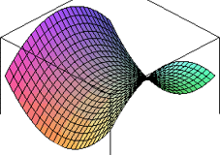
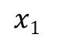
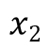
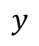
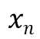
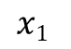
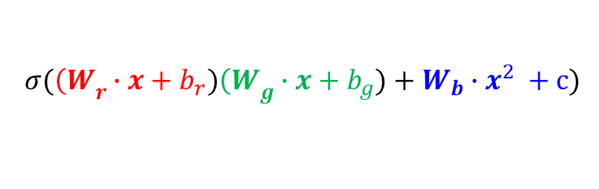
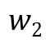
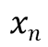
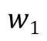
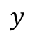
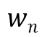
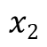
Quadratic Neuron (3n Parameters)
Conventional Neuron
Quadratic Neuron
Linear
Nonlinear
Nonlinear
Nonlinear
$$x1$$
$$w1$$
$$x1$$
$$w2$$
$$y$$
$$y$$
$$x2$$
$$x2$$
…
$$wn$$
Output
…
$$xn$$
Inner Product
$$xn$$
Quadratic
Form
Input
$$σ({\left(W\right.}_{r}∙x+b_{r}){\left(W\right.}_{g}∙x+b_{g})+{W_{b}∙x}^{2} +c)$$
Fan FL, Cong WX, Wang G: A new type of neurons for machine learning. International journal for numerical methods in biomedical engineering 34:p.e2920, 2018

Slide 20
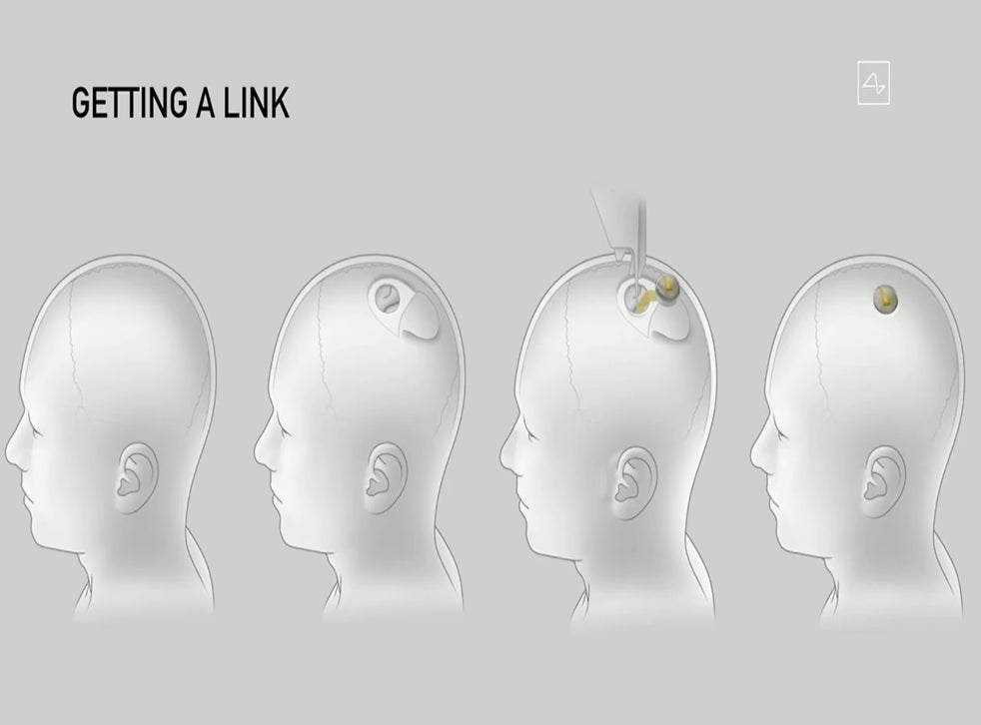

Neuralink

Slide 21
Outline
Neuron: Biomimicry, Integration, Activation
Network: Connectionism, Feedforward
Backpropagation: Loss, Optimization, Chain Rule

Slide 22

Symbolic & Connectionism Approaches
https://www.researchgate.net/figure/Properties-of-Symbolic-and-Connectionist-approaches_tbl1_228848818
https://en.wikipedia.org/wiki/Connectionism

Slide 23


Human Vision System vs Neural Network

Slide 24

Biological Feedforward Neural Network
https://www.spiedigitallibrary.org/conference-proceedings-of-spie/11113/111131P/Training-artificial-neurons-an-introduction-to-machine-learning/10.1117/12.2530718.full

Slide 25


Slide 26

Neural Network: Complicated Example
https://towardsdatascience.com/generalized-linear-models-8738ae0fb97d

Slide 27

Fully-connected Neural Network
https://www.spiedigitallibrary.org/conference-proceedings-of-spie/11113/111131P/Training-artificial-neurons-an-introduction-to-machine-learning/10.1117/12.2530718.full

Slide 28

Convolutional Neural Network

Slide 29




Convolution: Edge Detection

Slide 30

Convolution: Inner Product

Slide 31



Convolution: Transposed

Slide 32

Pooling Strategy

Slide 33
Outline
Neuron: Biomimicry, Integration, Activation
Network: Connectionism, Feedforward
Backpropagation: Loss, Optimization, Chain Rule

Slide 34
Simplistic Example
We want to train a network to perform
f(x₁,x₁) = 2*x₁ + 3*x₂– 5
Use a single simplified neuron network
x₁
Output=ax₁+bx₂+ c
x₁

Slide 35
Iterative Refinement
x₁
Output=ax₁+bx₂+ c
x₁
Assume the parameters a, b and c are 0;
Try an example: f(1,4) = 9;
Compare the current output (0) with the desired one (9);
Adjust the parameters to match the desired output;
Iterative with more examples until convergence

Slide 36

Loss Function

Slide 37

Mean Squared Error

Slide 38

Backpropagation Algorithm (Book)
(3.17)

Slide 39

Backpropagation Algorithm (Blog)
https://mattmazur.com/2015/03/17/a-step-by-step-backpropagation-example/

Slide 40



Incremental Value of a Function
Functional Approximation
Directional Derivative

Slide 41


Learning Rate
Learning Rate Should be Optimized
Too Small – Long Time
Too Large – Divergent

Slide 42

Toy Example 1
https://www.spiedigitallibrary.org/conference-proceedings-of-spie/11113/111131P/Training-artificial-neurons-an-introduction-to-machine-learning/10.1117/12.2530718.full

Slide 43

Poor Outputs
0.8645
0.6624

Slide 44


Refinement of w₉ (Similarly, Other Parameters)
Weight
net
out

Slide 45




Slide 46

Homework (Due 5 Working Days Later)
1. Cut the input variables by half and compute the outputs
2. Understand the BP derivation (3.1.7 in our book)
https://www.spiedigitallibrary.org/conference-proceedings-of-spie/11113/111131P/Training-artificial-neurons-an-introduction-to-machine-learning/10.1117/12.2530718.full

Slide 47




Key Points in BP Derivation

Slide 48


